Slide 1
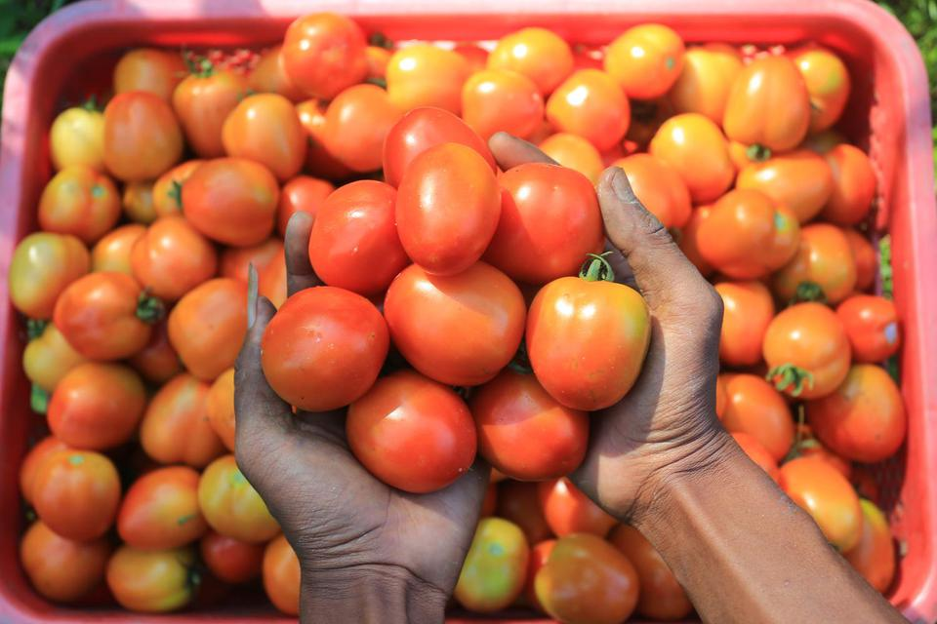


Universitas Brawijaya
Development of CNN Model with ADAMax Optimizer to Classify Tomato Leaf Diseases
Presented by:
Syaiful Anam^{1, a)}
Abdi Negara Guci^{1, b)},
Hagus Tarno^{2, c)}, Fidia Deny Tisna Amijaya^{3, d)},
Zuraidah Fitriah^{1, e)}

Slide 2
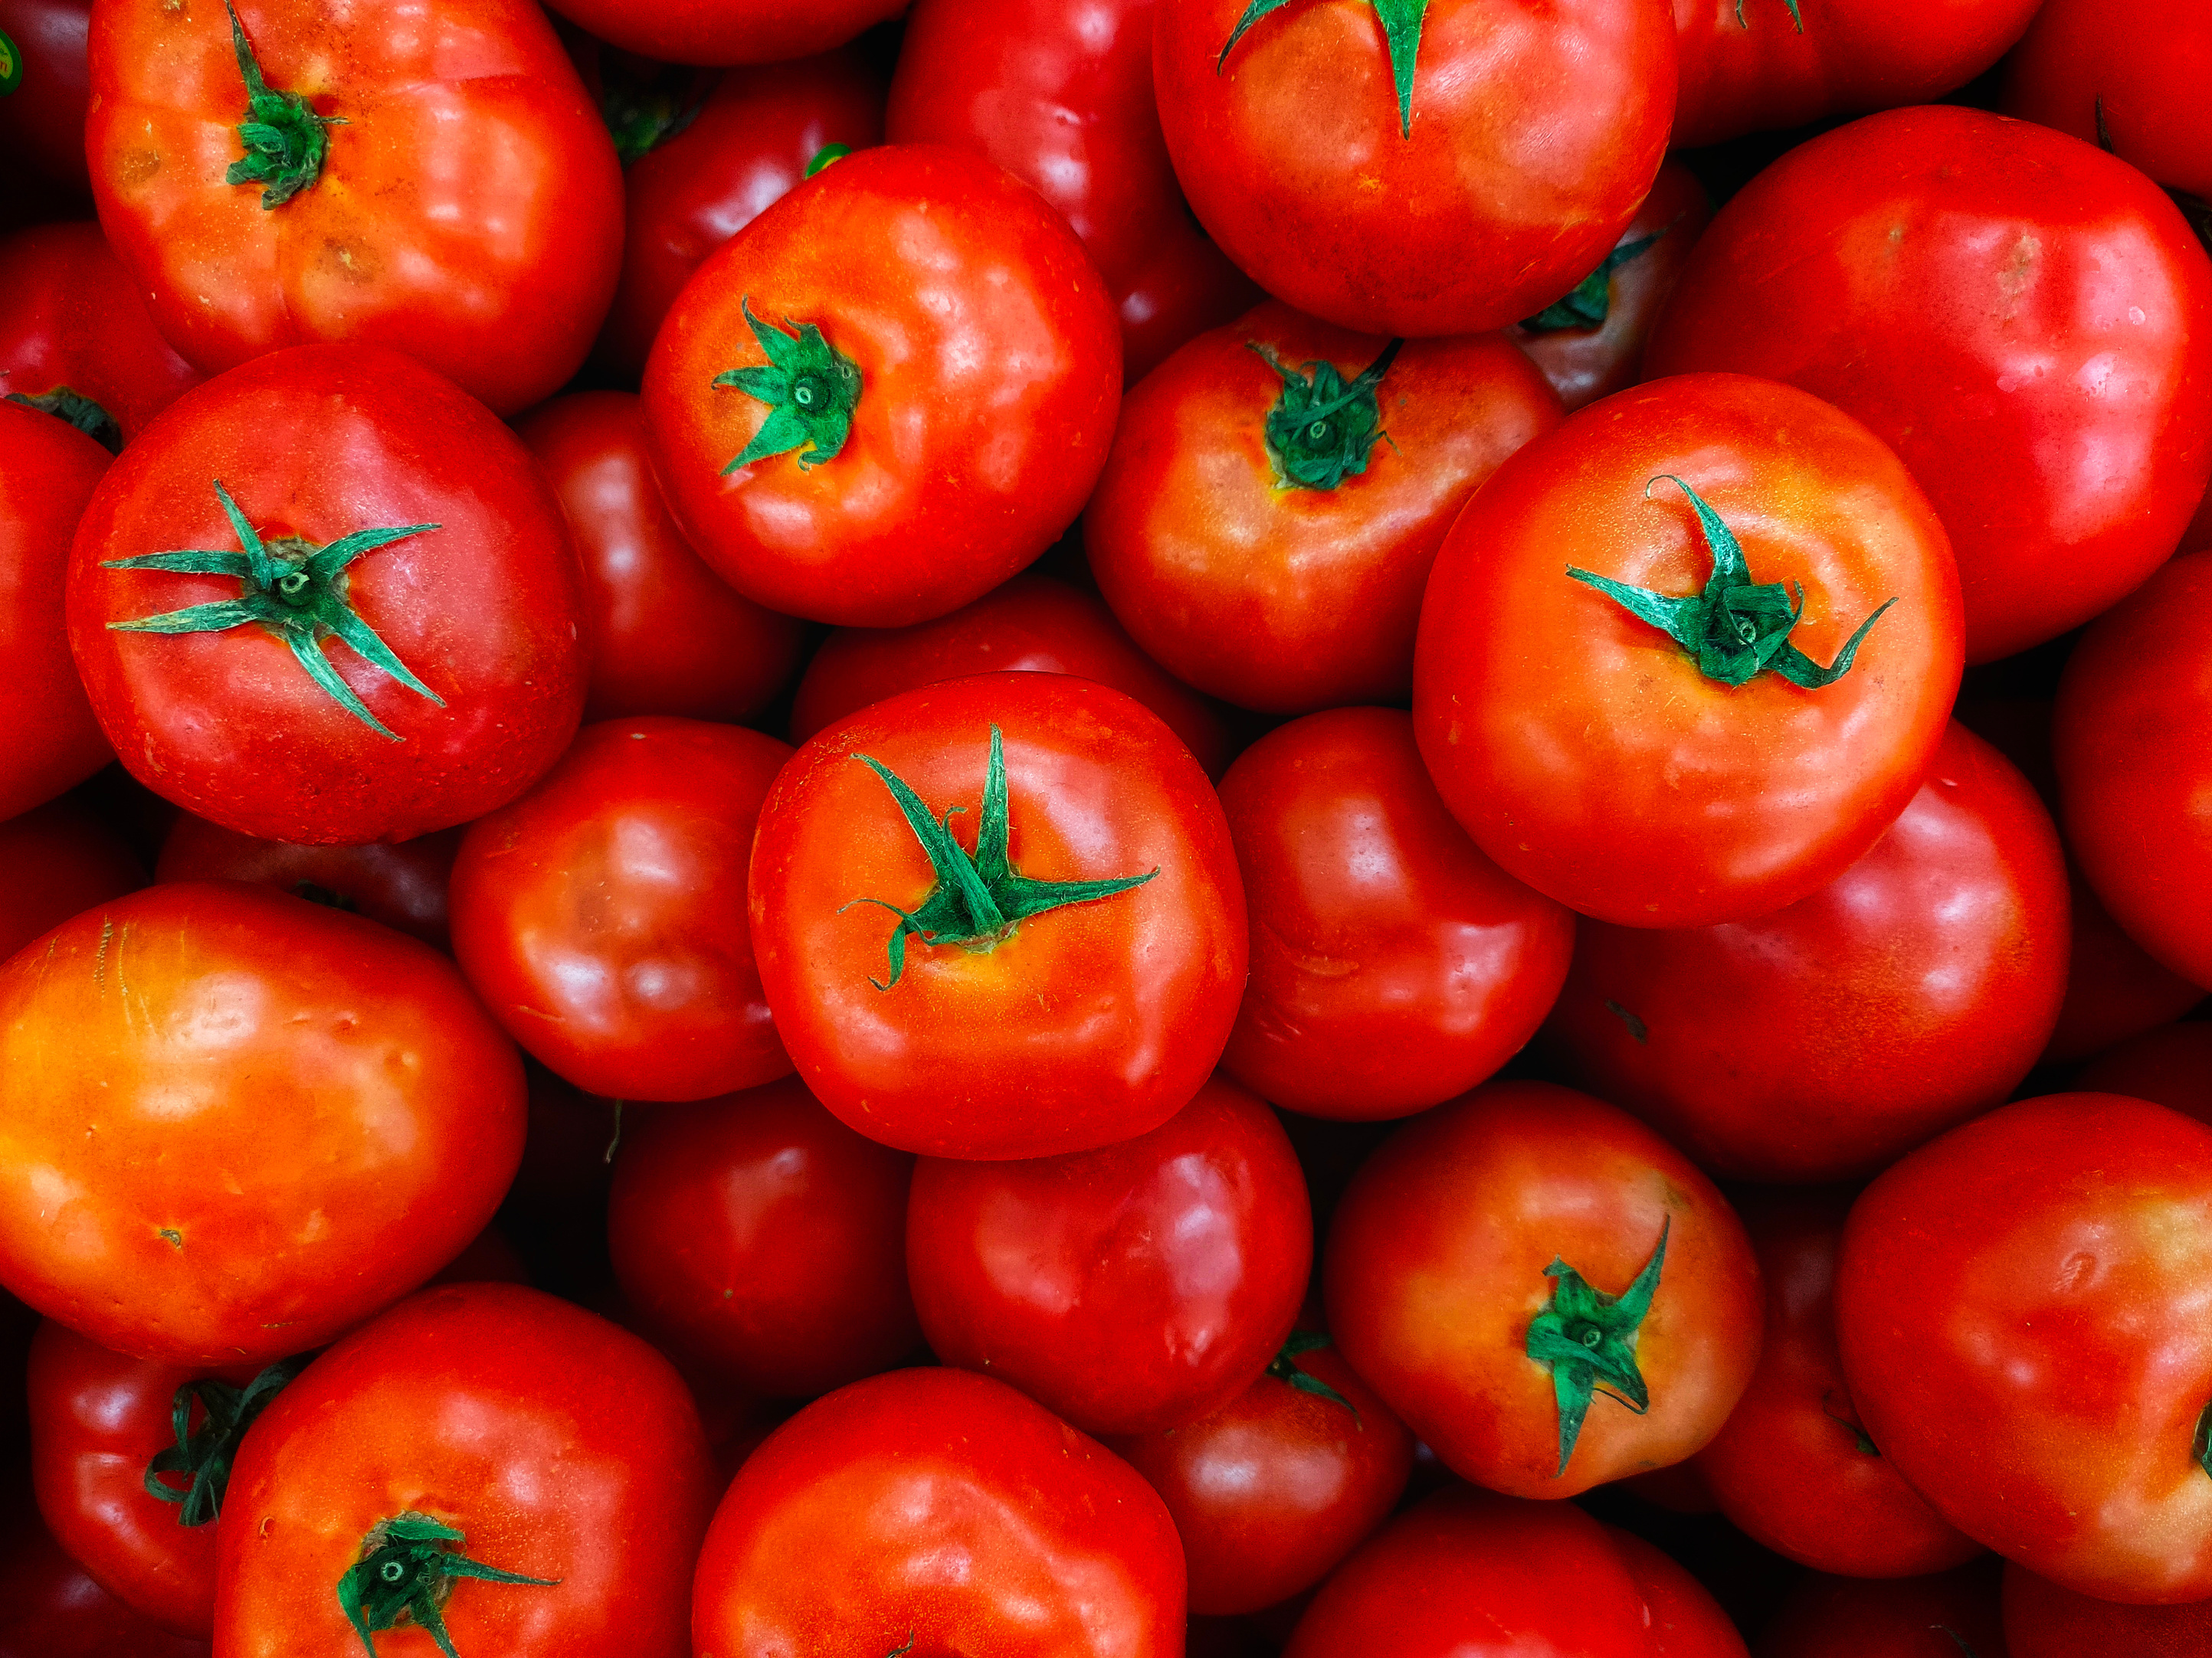
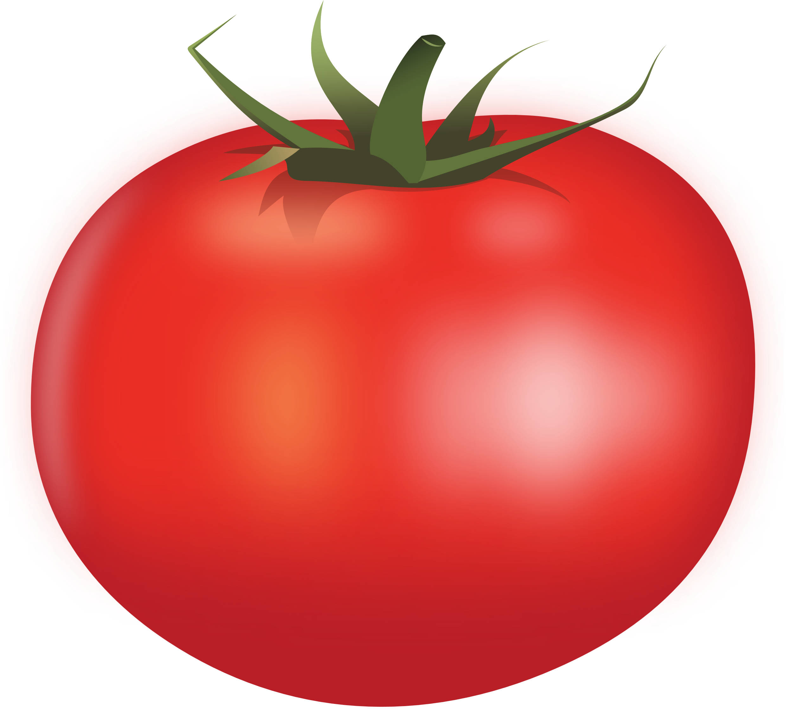
BACKGROUND
TOMATOeS
A horticultural crop is widely grown by people in Indonesia
More than seven billion people worldwide consume tomatoes as food

Slide 3
BACKGROUND
high economic value
tOMATOES
Very high production
good for health

Slide 4
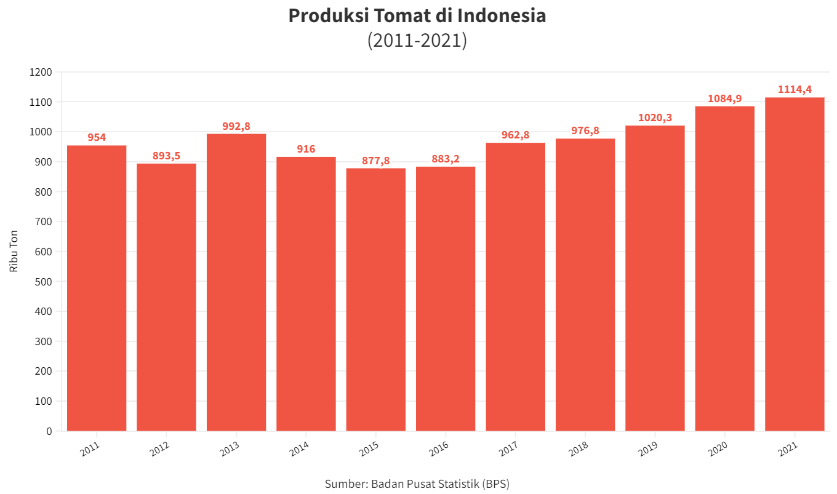
Tomato Production in indonesiao

Slide 5
Tomato Production in indonesiao
Increased Tomato Production Continues to Rise in the Last 5-6 Years
Linear
Source

Slide 6
BACKGROUND
TOMATOeS

Slide 7
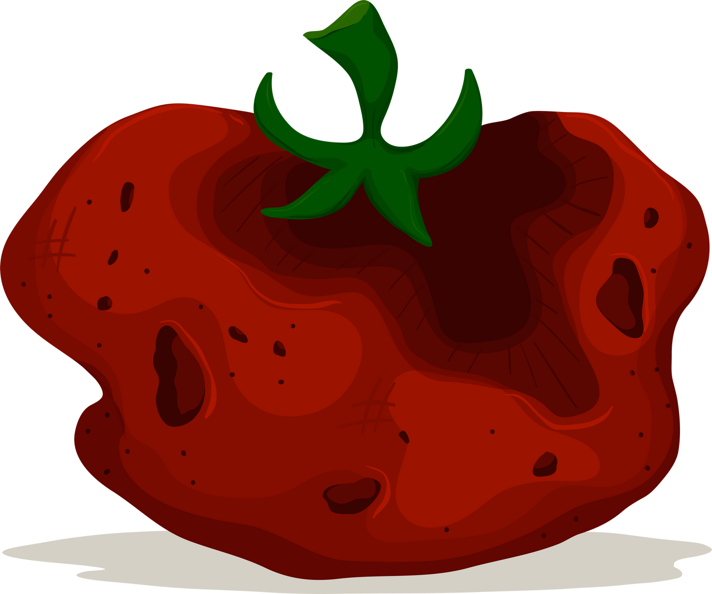
BACKGROUND: Decreasing of Tomato Production
Rotten Tomatoes

Slide 8
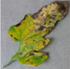
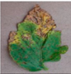
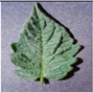
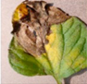
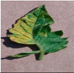
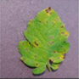
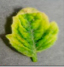
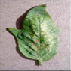
BACKGROUND

Slide 9

BACKGROUND
Automatics
Bacterial Spot

Slide 10

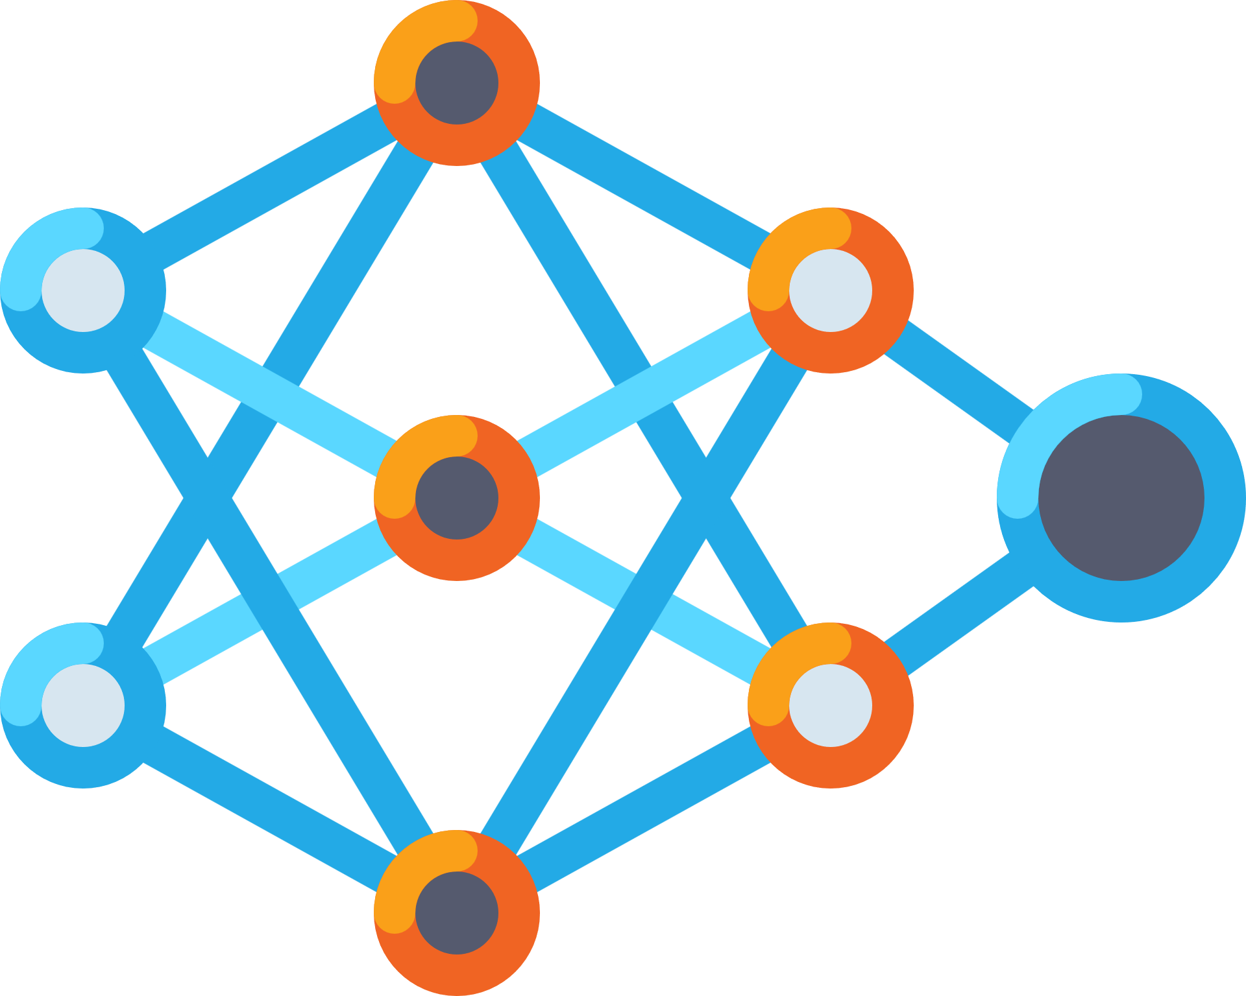
BACKGROUND
Machine Learning
Bacterial Spot

Slide 11
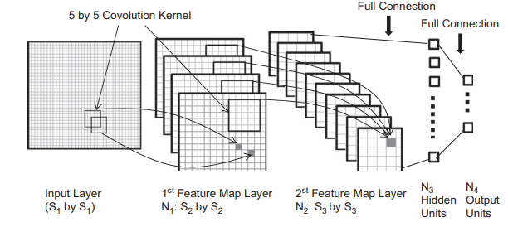
BACKGROUND
Convolutional Neural Network

Slide 12
BACKGROUND
Convolutional Neural Network
Keunggulan
Benefit
Can Handle Big Data
Automatic Extraction Feature
Capable of being used in Digital Imagery

Slide 13
BACKGROUND
Convolutional Neural Network
Keunggulan
Benefit
Can Handle Big Data
Automatic Extraction Feature
Capable of being used in Digital Imagery
Kelemahan
Manual parameter selection
Disadvantages

Slide 14
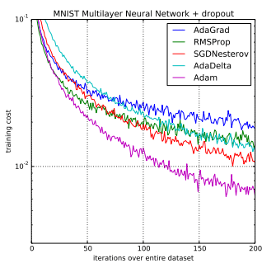
BACKGROUND
Convolutional Neural Network
Architectures
Optimizer
Adamax
Adam
SGD
RMSPROP
Adagrad

Slide 15
PROPOSED METHOD
a new CNN model with ADAMax Optimizer to classify diseases on tomato leaves

Slide 16

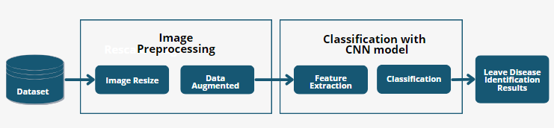
Universitas Brawijaya
Research flow

Slide 17
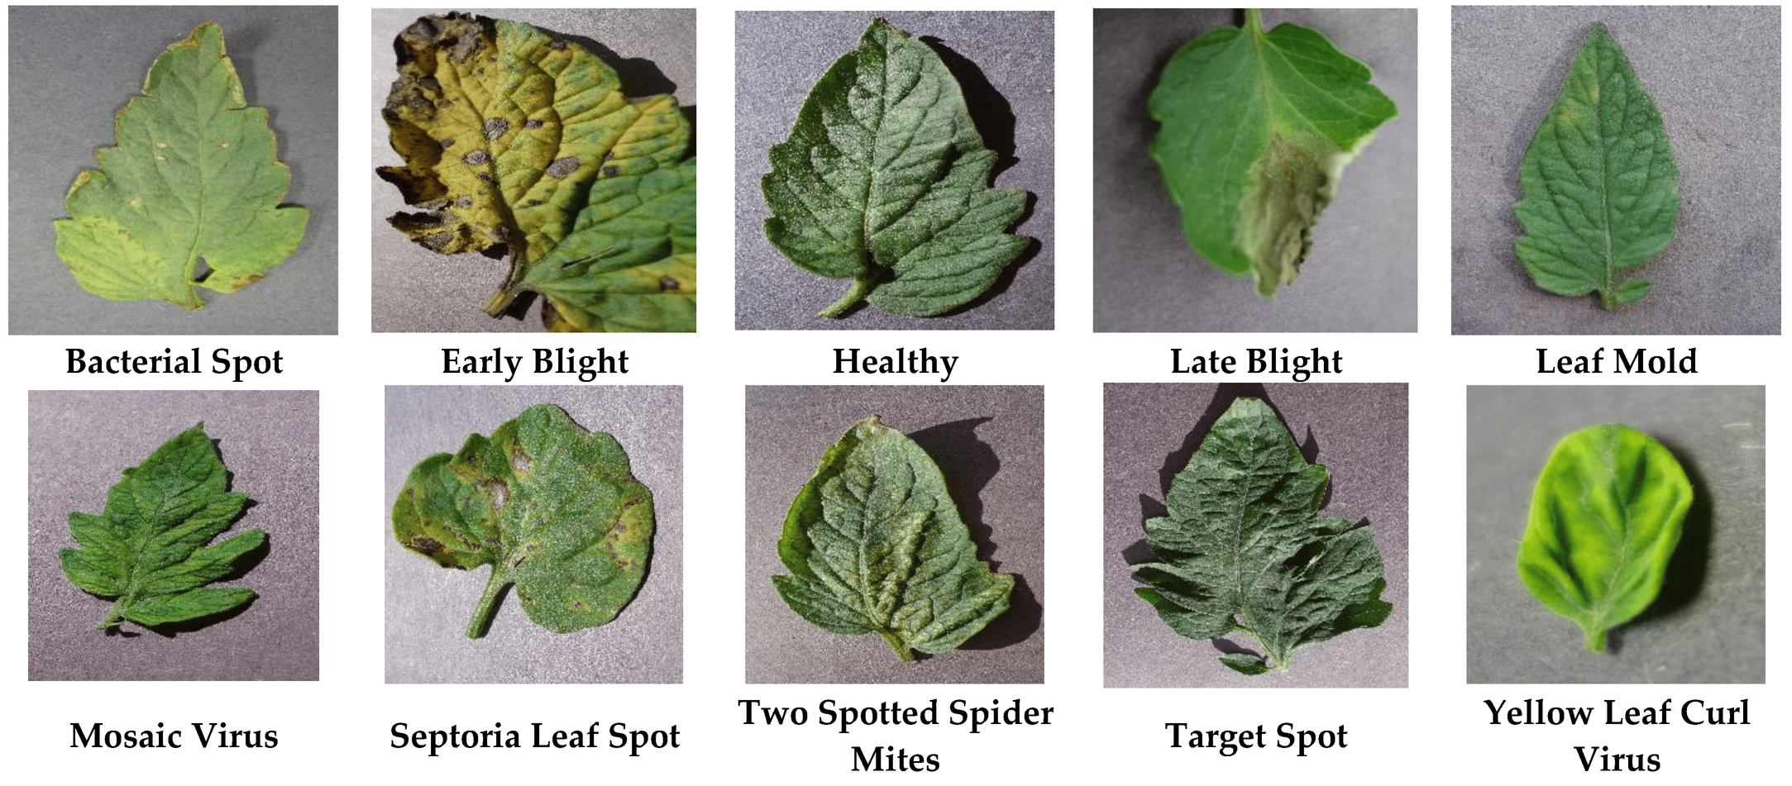
Methodology
TOMATO LEAF DISEASES

Slide 18
Methodology
Has 18000 training data and 4000 testing data
Analyze with python programming language
Penyakit Daun Tomat
Obtaining from Kaggle website
With 150x150x3 input size

Slide 19
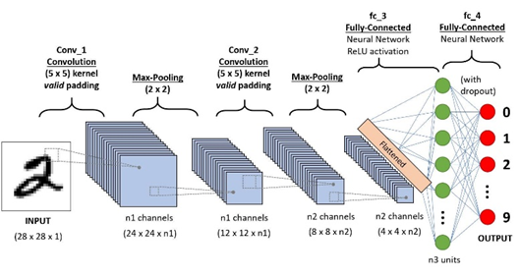
Methodology
Convolutional Neural Network

Slide 20
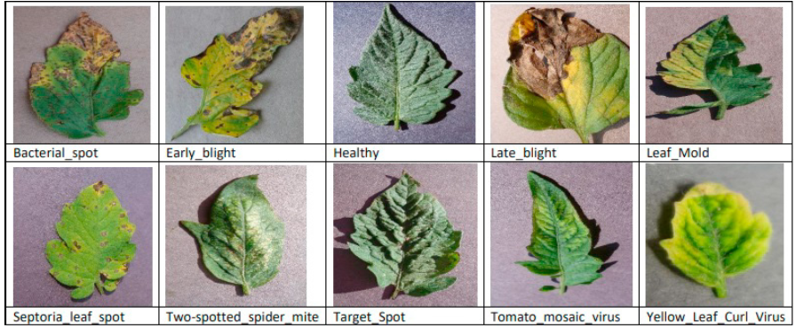
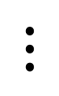
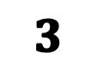
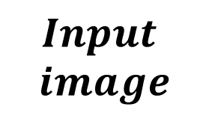
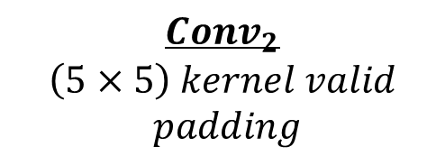

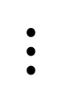
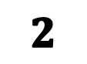
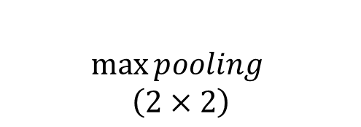


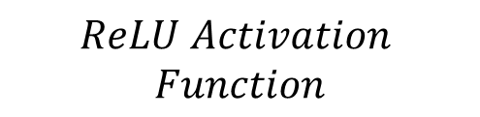
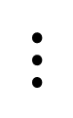
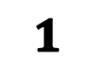
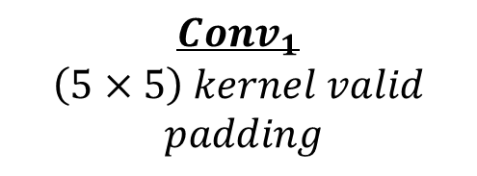

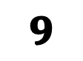

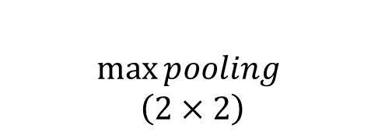



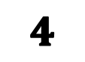

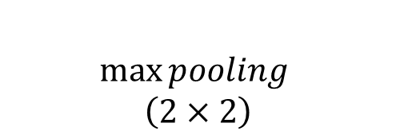
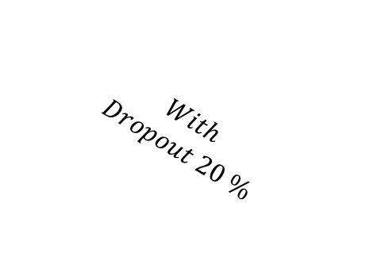
$$ReLU Activation$$
$$Function$$
$$Conv_{1}$$
$$\left(5×5\right) kernel valid$$
$$padding$$
$$\max{pooling }$$
$$\left(2×2\right)$$
$$Conv_{2}$$
$$\left(5×5\right) kernel valid$$
$$padding$$
$$\max{pooling }$$
$$\left(2×2\right)$$
$$\max{pooling }$$
$$\left(2×2\right)$$
$$Flatten$$
$$Layer$$
$$With$$
$$Dropout 20 \%$$
$$Input$$
$$image$$
$$Convolutional Layer$$
$$Convolutional Layer$$
$$1$$
$$2$$
$$3$$
$$4$$
$$Pooling Layer$$
$$Pooling Layer$$
$$⋮$$
$$input$$
$$28×28×1$$
$$n_{1} Channel$$
$$24×24×n_{1}$$
$$n_{1} Channel$$
$$12×12×n_{1}$$
$$n_{2} Channel$$
$$8×8×n_{2}$$
$$n_{2} Channel$$
$$4×4×n_{2}$$
$$⋮$$
$$9$$
$$⋮$$
$$Output$$
$$fully connected$$
$$Layer$$

Slide 21
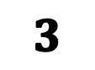
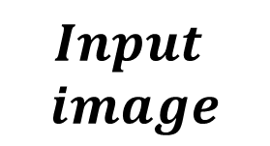


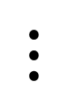
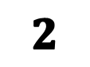
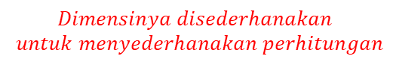


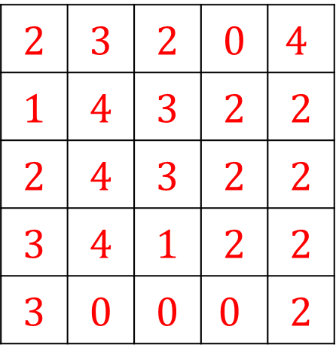
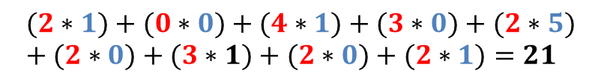
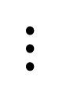
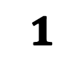
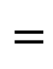
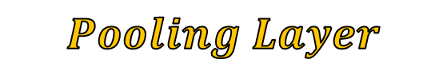
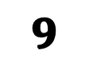

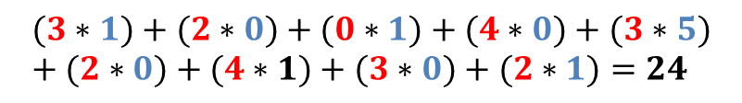




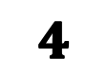





$$Flatten$$
$$Layer$$
$$Input$$
$$image$$
$$Convolutional Layer$$
$$Convolutional Layer$$
$$1$$
$$2$$
$$3$$
$$4$$
$$input$$
$$28×28×1$$
$$Pooling Layer$$
$$Pooling Layer$$
$$⋮$$
$$Dimensinya disederhanakan$$
$$untuk menyederhanakan perhitungan$$
$$⋮$$
$$9$$
$$input\left(X\right)$$
$$5×5×1$$
$$⋮$$
$$(2∗1)+(3∗0)+(2∗1)+(1∗0)+(4∗5)+(3∗0)+(2∗1)+(4∗0)+(3∗1)=29$$
$$Output$$
$$Kernel \left(K\right)$$
$$3×3×1$$
$$Filter \left(F\right)$$
$$3×3×1$$
2 | 3 | 2 | 0 | $$4$$
1 | 4 | 3 | 2 | 2
2 | 4 | 3 | 2 | 2
3 | 4 | 1 | 2 | 2
3 | 0 | 0 | $$0$$ | 2
29 | 24 | 21
28 | 27 | 18
28 | 11 | 17
$$(3∗1)+(2∗0)+(0∗1)+(4∗0)+(3∗5)+(2∗0)+(4∗1)+(3∗0)+(2∗1)=24$$
1 | 0 | 1
0 | 5 | 0
1 | 0 | 1
$$∗$$
$$=$$
$$fully connected$$
$$Layer$$
$$(2∗1)+(0∗0)+(4∗1)+(3∗0)+(2∗5)+(2∗0)+(3∗1)+(2∗0)+(2∗1)=21$$
$$⋮$$
$$(3∗1)+(2∗0)+(2∗1)+(1∗0)+(2∗5)+(2∗0)+(0∗1)+(0∗0)+(2∗1)=17$$
$$Stride\left(S\right) =1$$
$$Padding(P)=0$$
$$dim\left(f\right)=\left(\dim\left(X\right)−\dim\left(K\right)+2P\right)S+1$$
$$=3$$
$$Rumus Konvolusi$$
$$F\left(i,j\right)=\sum_{p=0}^{k_{m}−1}{\sum_{q=0}^{k_{n}−1}{X\left(i+p,j+q\right)∗K\left(q , p\right)}}.$$

Slide 22










$$Conv_{1}$$
$$\left(5×5\right) kernel valid$$
$$padding$$
$$\max{pooling }$$
$$\left(2×2\right)$$
$$Flatten$$
$$Layer$$
$$Input$$
$$image$$
$$Convolutional Layer$$
$$Convolutional Layer$$
$$1$$
$$2$$
$$3$$
$$4$$
$$Pooling Layer$$
$$Pooling Layer$$
$$⋮$$
$$input$$
$$28×28×1$$
$$n_{1} Channel$$
$$24×24×n_{1}$$
$$n_{1} Channel$$
$$12×12×n_{1}$$
$$⋮$$
$$⋮$$
$$9$$
Objective: to reduce the dimensionality of the features generated by the convolution layer in the CNN, while retaining the most important information.
$$Output$$
$$Feature map(F)$$
$$3×3×n_{1}$$
$$Pooling Layer\left(θ\right)$$
$$2×2×n_{1}$$
29 | 24 | 21
28 | 27 | 18
28 | 11 | 17
$$Ilustrasi$$
29 | 27
28 | 27
$$fully connected$$
$$Layer$$
$$=$$

Slide 23

$$Conv_{1}$$
$$\left(5×5\right) kernel valid$$
$$padding$$
$$\max{pooling }$$
$$\left(2×2\right)$$
$$Flatten$$
$$Layer$$
$$Input$$
$$image$$
$$Convolutional Layer$$
$$Convolutional Layer$$
$$1$$
$$2$$
$$3$$
$$4$$
$$Pooling Layer$$
$$Pooling Layer$$
$$⋮$$
$$input$$
$$28×28×1$$
$$n_{1} Channel$$
$$24×24×n_{1}$$
$$n_{1} Channel$$
$$12×12×n_{1}$$
$$⋮$$
$$⋮$$
$$9$$
Objective: to reduce the dimensionality of the features generated by the convolution layer in the CNN, while retaining the most important information.
$$Output$$
$$Feature map(F)$$
$$3×3×n_{1}$$
$$Pooling Layer\left(θ\right)$$
$$2×2×n_{1}$$
29 | 24 | 21
28 | 27 | 18
28 | 11 | 17
$$Ilustratation$$
29 | 27
28 | 27
$$fully connected$$
$$Layer$$
$$=$$

Slide 24











$$Conv_{1}$$
$$\left(5×5\right) kernel valid$$
$$padding$$
$$\max{pooling }$$
$$\left(2×2\right)$$
$$\max{pooling }$$
$$\left(2×2\right)$$
$$Flatten$$
$$Layer$$
$$Conv_{2}$$
$$\left(5×5\right) kernel valid$$
$$padding$$
$$Input$$
$$image$$
$$Convolutional Layer$$
$$Convolutional Layer$$
$$1$$
$$2$$
$$3$$
$$4$$
$$Pooling Layer$$
$$Pooling Layer$$
$$⋮$$
$$input$$
$$28×28×1$$
$$n_{1} Channel$$
$$24×24×n_{1}$$
$$n_{1} Channel$$
$$12×12×n_{1}$$
$$n_{2} Channel$$
$$8×8×n_{2}$$
$$n_{2} Channel$$
$$4×4×n_{2}$$
$$⋮$$
$$⋮$$
$$9$$
$$Flatten Layer$$
$$Output$$
29 | 27
28 | 27
29 | 27
28 | 27
29 | 27
28 | 27
29 | 27
28 | 27
Each $feature$
$$has different value$$
29 | 27
28 | 27
$$n Feature$$
29 | 27
28 | 27
29 | 27
28 | 27
3 | 0
2 | 11
$$fully connected$$
$$Layer$$
29 | 27
28 | 27
3 | -12
2 | 11
29 | 27
28 | 27
29 | 27
28 | 27
$$\left(ReLU\right)$$
29 | 27
28 | 27
4 | -1
8 | 40
$$f\left(x\right)=\max\left(0,x\right)$$
4 | 0
8 | 40
$$⋮$$
$$⋮$$
4 | 50
-30 | 12
4 | 50
0 | 12

Slide 25



































$$29$$
$$dropout:Reduce model generalization to reduce overfitting$$
$$feature$$
$$Feedforward$$
$$−backforward$$
$$27$$
29 | 27
28 | 27
$$28$$
$$1$$
3 | 12
2 | 11
$$Predicted$$
$$output (y_{i})$$
$$27$$
$$2$$
$$Loss$$
$$Function$$
$$Output$$
4 | 1
8 | 40
$$3$$
$$L=\left(\frac{1}{N}\sum_{i}^{N}{y_{i}−\overline{y_{i}}}\right)$$
$$3$$
$$4$$
$$⋮$$
$$⋮$$
$$Actual$$
$$output \left(\overline{y_{i}}\right)$$
$$12$$
4 | 50
30 | 12
$$9$$
$$⋮$$
$$2$$
$$⋮$$
$$output layer$$
$$Objective:to minimize Loss function$$
$$Intuisi:$$
$$Setiap neuron memiliki w dan b$$
$$yang akan terus di update$$
$$12$$
$$Hidden layer$$
$$w_{1}$$
$$Input layer$$
$$h\left(\sum_{i}^{n}{w_{i}x_{i}+b}\right)$$
$$w_{2}$$
$$b$$

Slide 26
methodology
Total parameter

Slide 27

Methodology
Data Augmented

Slide 28
Universitas Brawijaya
Result

Slide 29
result
Hardware Spesification

Slide 30
result
Hyperparameter

Slide 31

result
Comparation of model

Slide 32
result
Val accuracy per epoch

Slide 33
result
Val accuracy per epoch

Slide 34

result
Visualization of accyracy and train accuracy

Slide 35
result
Thank you

